Slide 1
Knowledge sharing
Introduction of API
API development using Flask
API Deployment

Slide 2
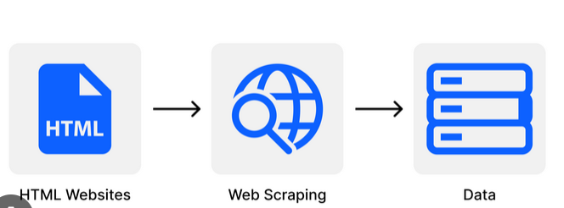
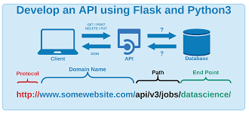

Slide 3
Application Programming Interface (API) simplifies the process of integrating various applications by providing readily available codes and information pipelines to assist developers in building robust digital solutions.
Representational State Transfer (REST) Rest is not a protocol or library. It is an architectural style that defines set of rules that developer should follow while creating API
REST API strictly operates on the web concept of Client and Server.
Other popular API paradigms include SOAP and GraphQL.
RESTful APIs predominantly operate via HTTP requests
RESTful APIs champion statelessness, ensuring each request remains independent without relying on prior or future requests.

Slide 4
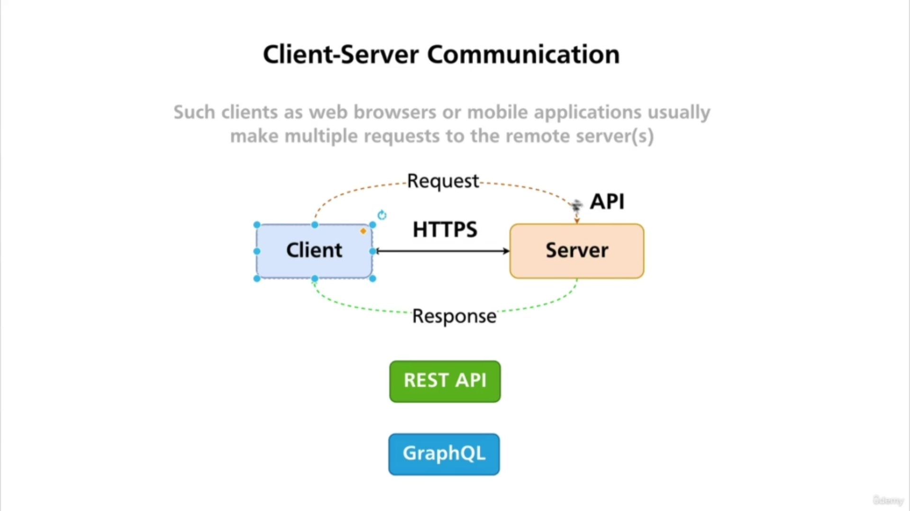

Slide 5
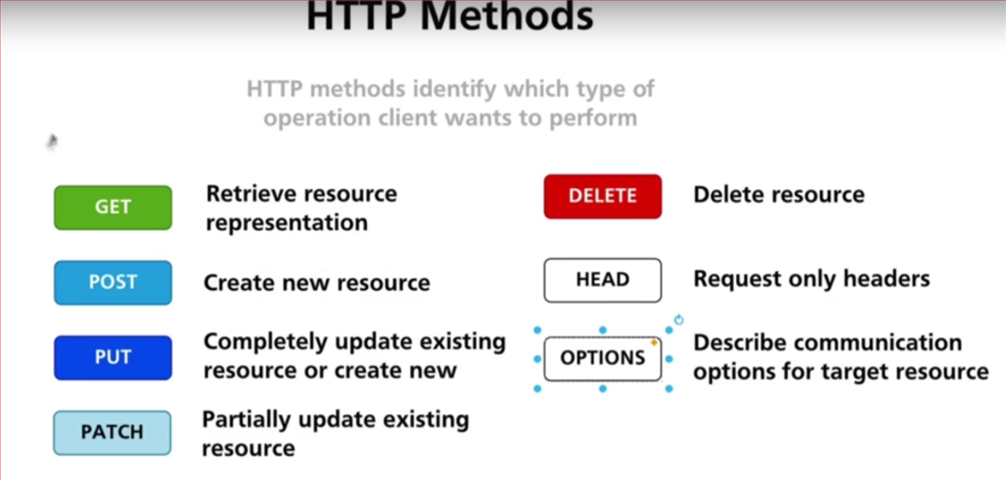

Slide 6
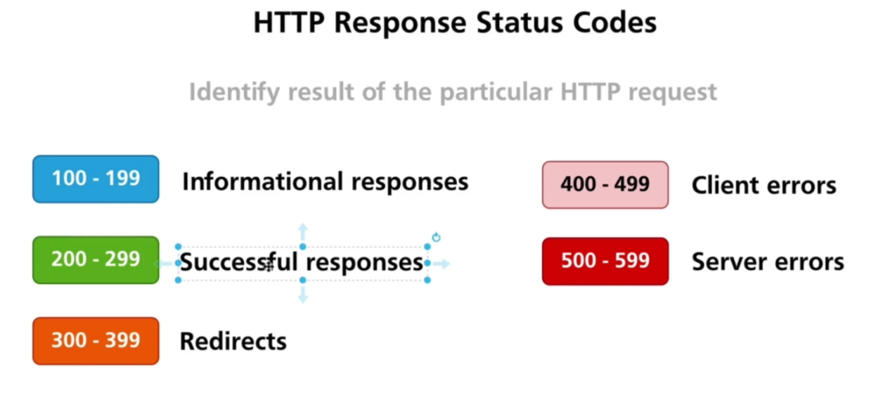

Slide 7
Basic API Implementation steps
Create virtual Environment
Install Python Flask
Create basic Flask Web server
Create end points
Test End points

Slide 8
Creating Python virtualenv in Windows
pip install virtualenv
python -m venv myenv
myenv\Scripts\activate
Deactivate
pip install Flask
Pip list

Slide 9
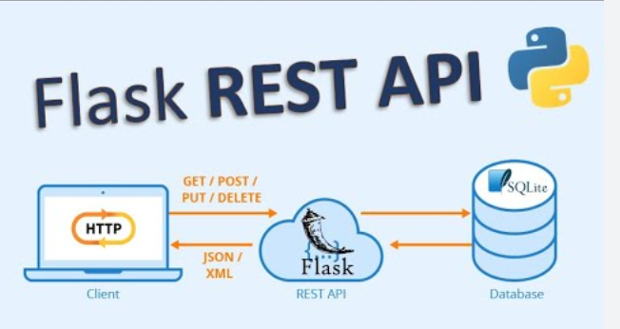
Flask Framework
Python-based web frameworks, It is a web framework that allows developers to build lightweight web applications quickly and easily with Flask Libraries. It was developed by Armin Ronacher, leader of the International Group of Python Enthusiasts(POCCO).

Slide 10
Demo
Hello world
@app.route("/")
def hello_world():
return "<p>Hello, World!</p>“
2 Name
@app.route('/name',methods=['GET']) # end point
def my_name():
return "<p>My name is Baijnath</p>“
3 Add_number
4 get_data

Slide 11
Deployment
Options for Deployment:-
Local Git
GitHub
Azure web
Power shell

Slide 12
Deployment on Azure
Create Resource group :- A resource group is a container that holds related resources for an Azure solution.
Create Web App :- A fully managed platform for building and hosting web applications using popular programming languages such as .NET, Java, Node.js, Python, and PHP. It includes features like automatic scaling, load balancing, traffic management, continuous deployment, and monitoring.
Create App Service Plan:- An App Service plan defines a set of compute resources for a web app to run.
Each App Service plan defines:
Operating System (Windows, Linux)
Region (West US, East US, and so on)
Number of VM instances
Size of VM instances (Small, Medium, Large)
Pricing tier (Free, Shared, Basic, Standard, Premium, PremiumV2, PremiumV3, Isolated, IsolatedV2)

Slide 13
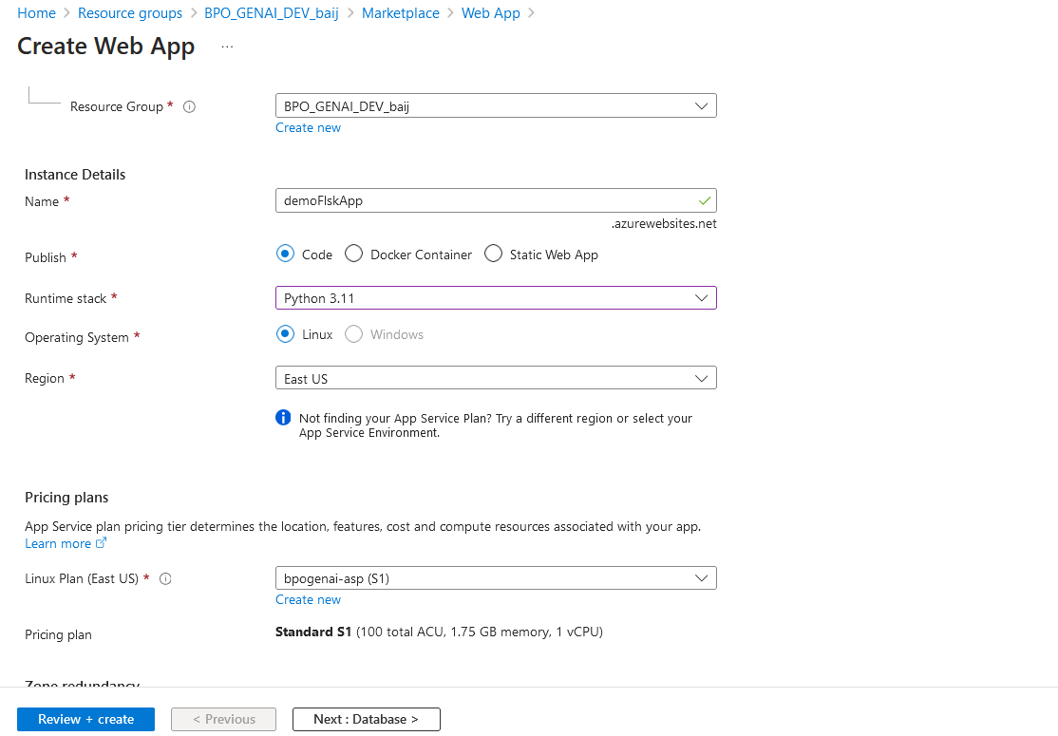
Deployment on Azure
Use resource group, Open -- BPO_GENAI_DEV_baij
Click on create – search web app -> click on web app
Click on web

Slide 14
Deployment on Azure

